Slide 1
SuiteCRM
Lecturer: Ngo Huy Bien
Software Engineering Department
Faculty of Information Technology
VNUHCM - University of Science
Ho Chi Minh City, Vietnam
nhbien@fit.hcmus.edu.vn

Slide 2

Objectives
To learn SuiteCRM by yourself.

Slide 3

Contents

Slide 4

References

Slide 5


We Need a Problem First!

Slide 6
Example Needs
Install internal CRM for XYZ company.
Install and configure SuiteCRM instance.

Slide 7


Slide 8
Find Appropriate Documentation
https://docs.suitecrm.com/admin/installation-guide/downloading-installing/
https://docs.suitecrm.com/admin/compatibility-matrix/
https://suitecrm.com/download/

Slide 9
Install SuiteCRM
Use default option first.

Slide 10
Enable SSL
Just enable SSL for nginx

Slide 11
Remove logo in upper left corner
Sass
https://docs.suitecrm.com/developer/theme/sass/
SuiteCRM Directory Structure
https://docs.suitecrm.com/developer/suitecrm-directory-structure/
Config
https://docs.suitecrm.com/developer/config/
Edit /custom/themes/SuiteP/tpls/login.tpls

Slide 13
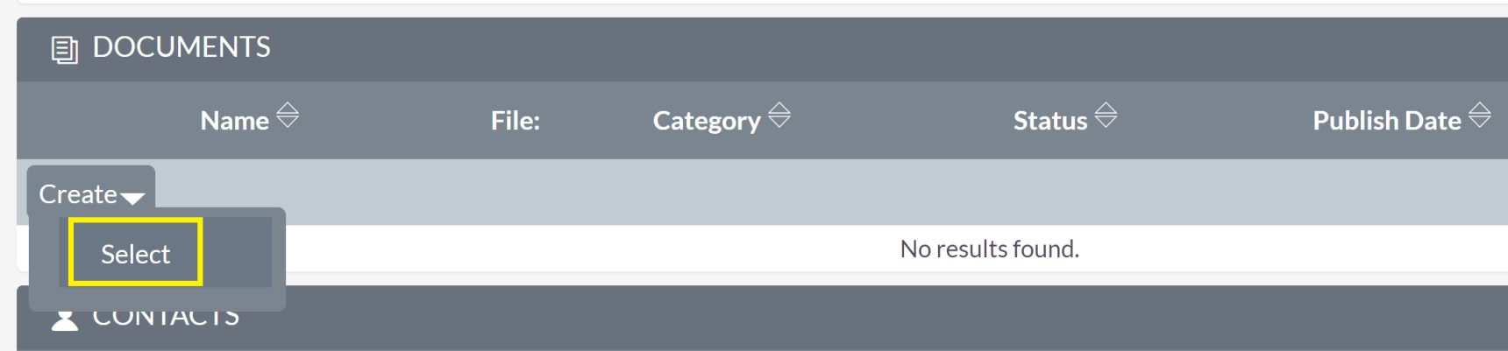
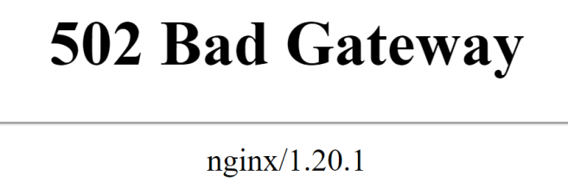
Issue: "Select" Document

Slide 14
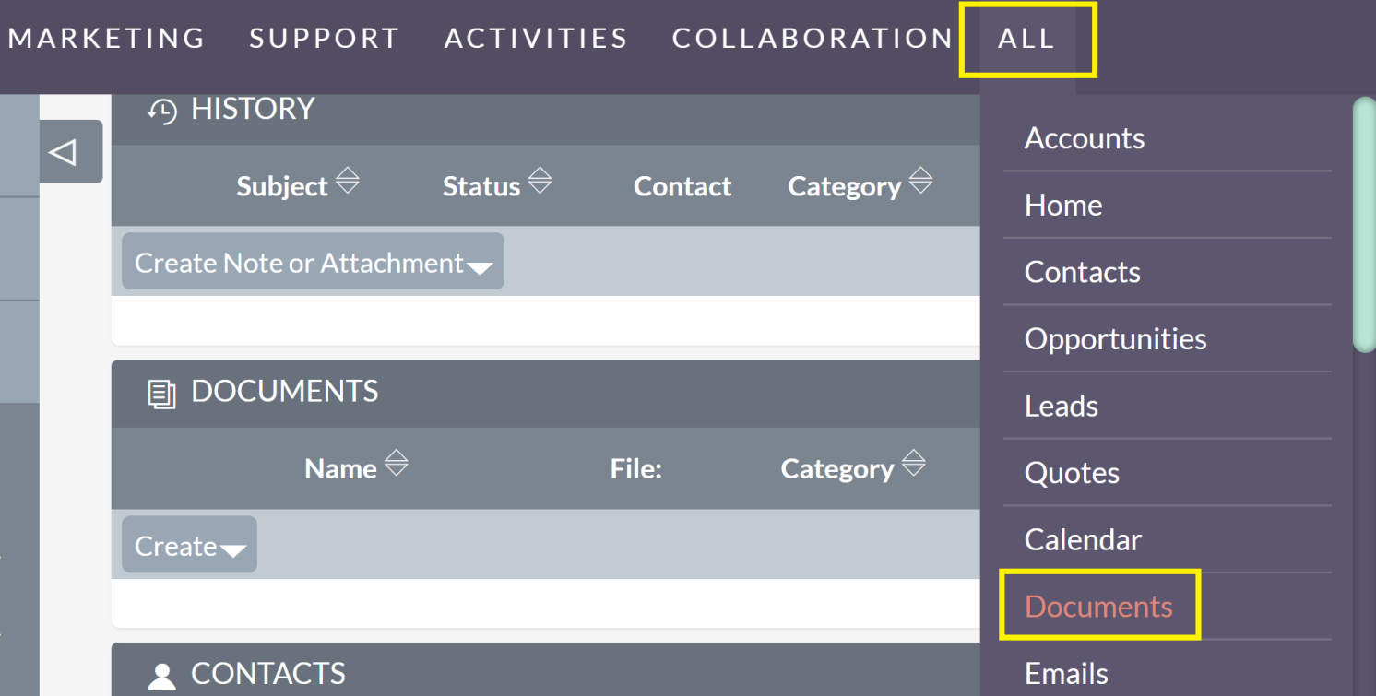
Read Documents Module Guide
https://docs.suitecrm.com/user/core-modules/documents/
https://example.com/index.php?module=Documents&action=index&parentTab=All

Slide 15
Detect SuiteCRM Version
https://example.com/index.php?module=Home&action=About

Slide 16
Detect SuiteCRM and PHP Compatibility
https://docs.suitecrm.com/admin/compatibility-matrix/

Slide 17
Upgrade SuiteCRM
https://suitecrm.com/upgrade-suitecrm/
https://crm.certifient.com/index.php?module=UpgradeWizard&action=index

Slide 18
Reinstall SuiteCRM
https://www.linuxbabe.com/ubuntu/install-suitecrm-ubuntu-20-04-apache-nginx

Slide 19

Thank You & See You Again

